Slide 1
Introduction to Digital Image Processing
By Dr.Charles O.Nyatega
Department of ETE, MUST

Slide 2
1.1 What is Digital Image Processing?
Digital Image Processing, or DIP, is the use of computer algorithms to manipulate, analyze, enhance, and interpret images. The input is a digital image, and the output may be:
an improved image
a set of measurements
or a decision, such as classification or detection.
An image can be viewed as a function:
𝑓(𝑥,𝑦), where 𝑥x and 𝑦y are spatial coordinates and 𝑓 is the intensity value at that point.
For grayscale images, 𝑓(𝑥,𝑦)f(x,y) takes a single intensity value.
For color images, each pixel usually contains three components: red, green, and blue.

Slide 3
1.2 Why study DIP?
DIP is important because images carry huge amounts of information. In medicine, a single X-ray or MRI scan can reveal disease. In agriculture, drone images can detect crop stress. In security, camera images support surveillance and recognition.
1.3 Main steps/techniques in DIP
A typical DIP pipeline includes:
Image acquisition
Preprocessing
Enhancement
Restoration
Segmentation
Feature extraction
Classification / interpretation

Slide 4
1.4 Applications
Medical imaging: X-ray , CT , MRI , fMRI , Ultrasound
Engineering: machine vision, defect detection, robotics
Remote sensing: land use mapping, weather monitoring
AI: object recognition, face detection, disease classification
Suppose a doctor acquires a chest X-ray. The raw image is too dark. DIP can:
improve contrast,
reduce noise,
isolate the lungs,
extract suspicious regions,
classify TB vs normal using AI.
That is a full DIP pipeline.
1.5 Worked example

Slide 5
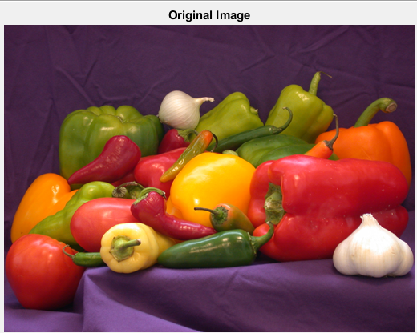
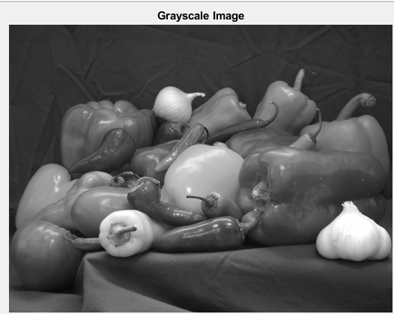
1.6 MATLAB example
img = imread('C:\Program Files\MATLAB\R2018a\toolbox\matlab\imagesci\peppers.png');
imshow(img);
title('Original Image');
For grayscale conversion:
img = imread('C:\Program Files\MATLAB\R2018a\toolbox\matlab\imagesci\peppers.png');
gray_img = rgb2gray(img);
imshow(gray_img);
title('Grayscale Image');

Slide 6
1.7 AI integration
AI uses image data as input, but good preprocessing often improves AI performance. This is why DIP is still essential even in the deep learning era.
1.8 Questions
Define digital image processing.
Differentiate image enhancement and image analysis.
Give three medical applications of DIP.
1.9 Answers
DIP is the use of algorithms to process digital images for improvement, measurement, or interpretation.
Enhancement improves appearance; analysis extracts information.
X-ray diagnosis, MRI analysis, tumor detection.

